Slide 1
THE GOLD DREGGER
Applied Capstone Project
Sudharshan P.R.
21/06/2021

Slide 2
CONTENTS
Background Discussion
Problem Description
Description Of The Data
Methodology
Results
Discussion
Conclusion

Slide 3
The Interesting Background
In the last decade, major cities in the U.S. have witnessed beer drinkers becoming beer lovers. This led to emergence of various craft brewery establishments that caters to the beer connoisseurs in their respective cities. Undoubtedly craft beers are being guzzled in gallons after gallons. This presents an interesting case for anyone looking beyond after finishing their beers.
The brewing process involves wheat or barley, hops and yeast along with a myriad of flavors. Once the beer portion of the process is extracted, there is the waste portion that remains collected. As it goes with waste from any organic process, this waste is actually wealth. This waste is nutritious since it still contains the solid portion of the ingredients that went into the beer making process.

Slide 4
The Interesting Background
The spent grains from beer is technically called as dreg(or trub - beer is a global drink - each region will have its term). This dreg isn't as bad as it sounds. In ancient to pre-modern times, this dreg was being fed to animals. And that is how dreg has been used up instead of rotting in a landfill. Interesting there are other uses of this dreg that can be more valuable than just being animal feed.
Here are a few examples of using spent grain from beer making:
Animal feed on farms
Dreg to baking goods
Wastewater treatment
Dreg to compost
Fish food
Energy generation (experimental and too technical, hence I am not interested too much in this application)

Slide 5
The Challenging Problem Description
The big brand commercial beers already have their waste matter handled. Since the factories are located in the rural side, its easy for them to just sell it to the animal farms. The problem faced is by the craft breweries who must link up with various other businesses to sell-off their dreg.
Here is an opportunity to bring in the dreg, assemble it in a place and sell it as raw materials to some of the businesses mentioned above. Part of the dreg can be sold to bakeries, to urban farms to make compost, off-shore fish farms and for wastewater treatment.
The missing piece of information that we need is how many craft breweries are there in any given city, say New York City?

Slide 6
Description Of The Data
The data we require is simple.
How many craft breweries are operational in New York City?
Which ones are the most popular?
Which ones have on-site brewing facilities
We can use the FourSquare API to gather all the breweries operating in New York City. Craft breweries are primarily located in Manhattan and Brooklyn, but we can expand it to all boroughs if required. Using this list of breweries along with their ratings, we can choose a smaller set of breweries to launch a pilot to evaluate the business. The FourSquare might not be able to answer the third question, for which we might need a beer or two from the place of interest. The data on a map should help us locate a few places of interest where we can have our dreg warehouse in or close to New York City.
Reference Link: https://modernfarmer.com/2015/08/recycled-brewery-waste/

Slide 7
Methodology
We use the FourSquare API which provides the option to list out all venues in a particular category. Each category has a specific ID in the FourSquare API using which we can find out how many venues of interest are there in a particular city or neighborhood.
For this particular problem, we need to get the category ID for breweries from the FourSquare developer site.
The FourSquare developer website is:
https://developer.foursquare.com/docs/build-with-foursquare/categories/
From here, we get the category ID for breweries: 50327c8591d4c4b30a586d5d
Using this category ID, we then list out all breweries in an area of interest using the following steps:
For the above business application, we will be looking at all NYC boroughs.
We then extract the list of all breweries along with their ratings, if available.
We then choose the 3 or 5 top rated venues to organize a field visit, get a few questions answered and guzzle down a few beers

Slide 8
Methodology
We use the FourSquare API which provides the option to list out all venues in a particular category. Each category has a specific ID in the FourSquare API using which we can find out how many venues of interest are there in a particular city or neighborhood.
For this particular problem, we need to get the category ID for breweries from the FourSquare developer site.
The FourSquare developer website is:
https://developer.foursquare.com/docs/build-with-foursquare/categories/
From here, we get the category ID for breweries: 50327c8591d4c4b30a586d5d
Using this category ID, we then list out all breweries in an area of interest using the following steps:
For the above business application, we will be looking at all NYC boroughs.
We then extract the list of all breweries along with their ratings, if available.
We then choose the 3 or 5 top rated venues to organize a field visit, get a few questions answered and guzzle down a few beers

Slide 9
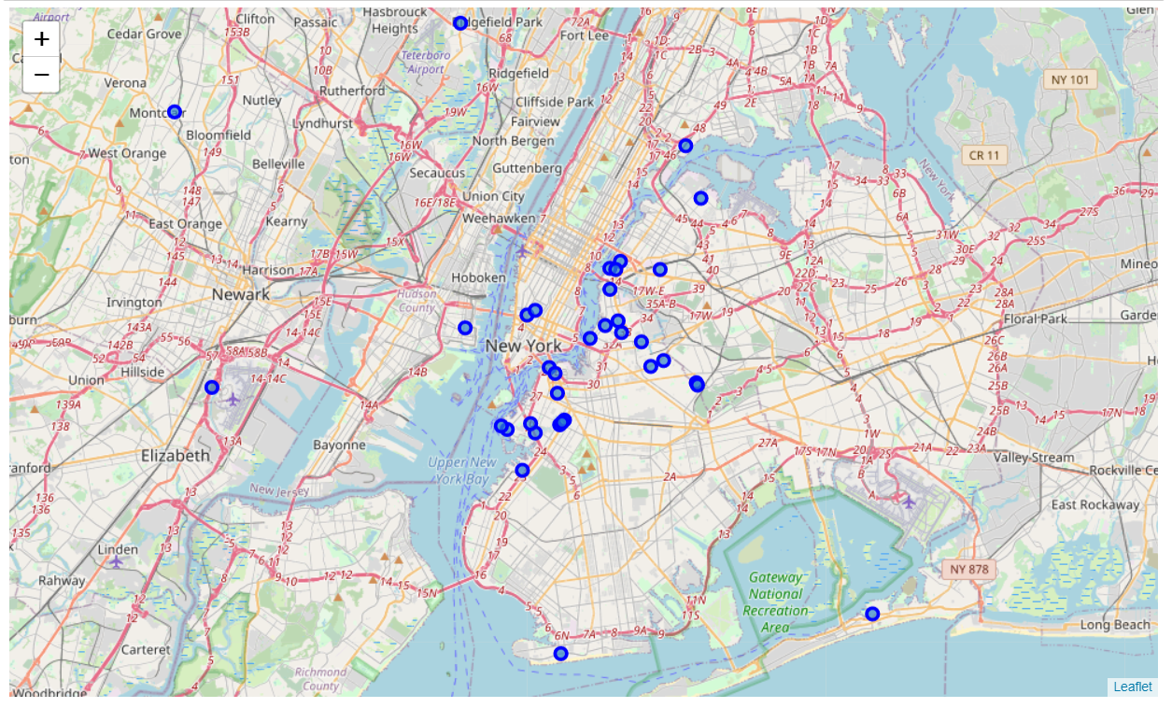
Results
As expected, a majority of the breweries are located in the NY region, specifically in Brooklyn, Queens and Manhattan.

Slide 10
Discussion
The Tri-borough area of Brooklyn, Manhattan and Queens (including Long Island City) is where the breweries are clustered. A location that is able to cover this area presents a valuable opportunity to source 'THE DREG' from these breweries.
Now we have the dreg, what next?
As an extension to the same project, we can use the FourSquare API to get the locations of farms (urban farms), wastewater plants, fisheries and bakeries to explore our business venture.

Slide 11
Discussion
Here are a few data science problems to solve:
- Once we have decided which businesses to partner with and selected which breweries to source from, we can solve a route optimizer for the sourcing and delivering processes
- If we decide upon more than one business, we have several problems to optimize our sourcing and selling between the different businesses
- Design different marketing campaigns for the sourcing breweries and business customers

Slide 12
Conclusion
Not all waste is actually waste, that it should end up in a landfill. Useful waste such as kitchen scraps and industrial food production always have other useful applications which needs to be explored and scaled up. This should help clean up the environment a little, stretch our resources to the maximum extent possible and contribute to building the community.

Slide 13
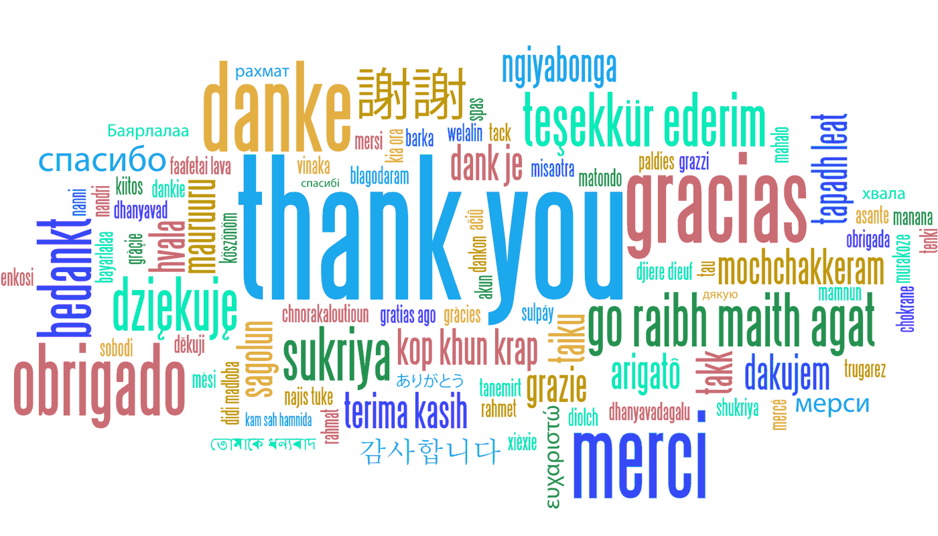
ENJOY THE DREGGING AND CHUGGING
Barrier Summary 1

